Slide 1
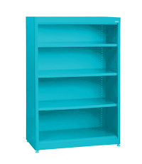
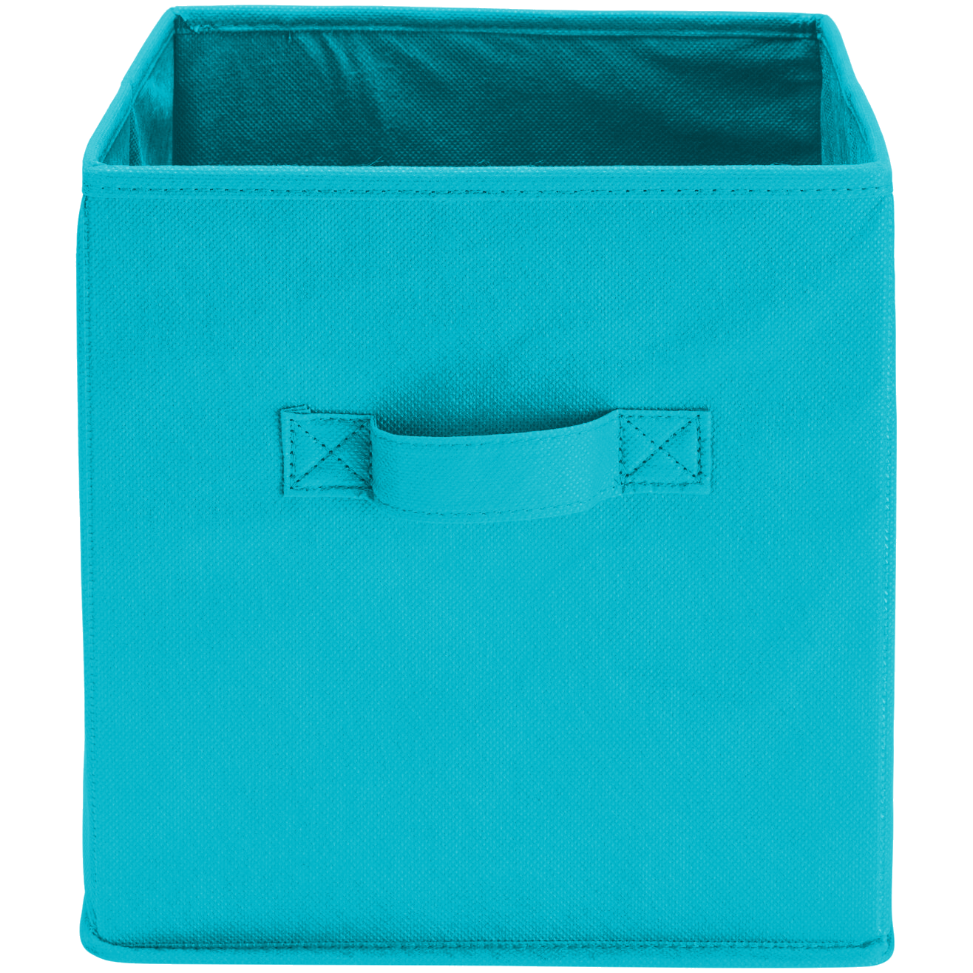
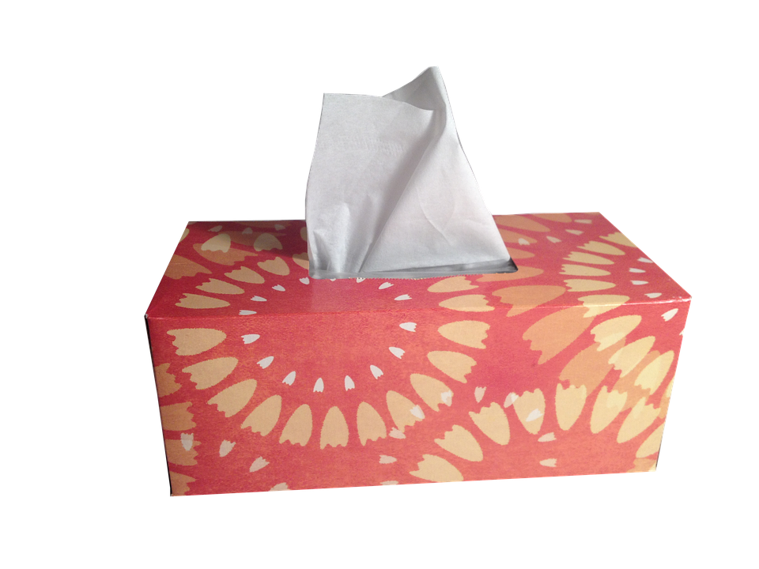
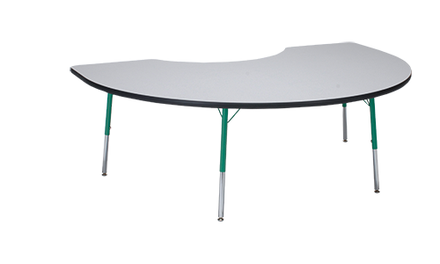
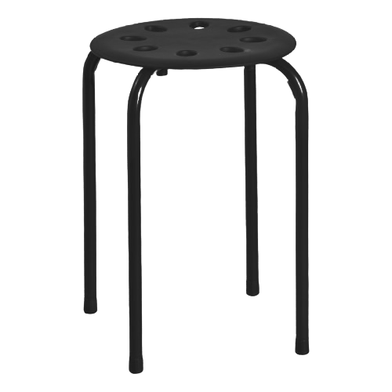
Welcome to
3rd Grade!

Slide 2
3rd grade 2023-2024
Mr. Baker, Mrs. brown, Ms. King, Ms. Lambie, Mrs. Lee, Mrs. Montejo, Ms. Moran, Mrs. Simpson

Slide 3
3rd grade schedule:
8:00 – 8:45 – W.I.N. Time 8:45 – 9:05 – Small Groups
9:05 – 9:50 – Science/Social Studies
9:50 – 10:10 – Recess
10:10 – 11:00 – Reading
11:00 – 11:45 – Specials 11:54 – 12:36 – Lunch (Each class will have a 30 minute block inside this time frame) 12:36 – 1:15 – Writing/ELA 1:15 – 2:00 – Math
2:10 – Dismissal

Slide 4
Homework Expectations
Students will be required to complete homework daily.
Homework will be sent home on Monday and will be due the following Monday.
Homework will include reading for 20 minutes nightly and math fact practice/skill review

Slide 5
Behavior Management
Earning and Losing Funny Money – during the first few weeks of school, each class will determine what behaviors earn/lose money and how much money the behavior will earn/lose them.

Slide 6
How you can contribute
End of Quarter Stores – we will ask for volunteers and donated items at the end of each quarter. We will hold a day where the students will get to spend their hard-earned Funny Money.
Economic Standards – 3rd graders will learn basic economic ideas. They will get to apply this learning to the Funny Money stores in the later quarters.

Slide 7
Materials
Teachers will help students organize materials during the first week of school.
Daily communication folder will come home each day. Students are expected to show you their folder nightly and empty any papers in the Keep at Home pocket.
Each student needs to have their own set of headphones by the second week of school.
Students may bring a water bottle with a secured top. Please ONLY send in water.
Students should bring a healthy snack to class each day.

Slide 8
Ctls parent
Make sure you can access CTLS Parent so that you will receive communication from teachers, school, and county.
Please ensure that your contact information is accurate in ParentVUE so that you will receive all communications.
You will need to download the CTLS Parent App on your mobile device to receive and respond to communication.
Teaching and learning is happening continually throughout the day. We will respond to CTLS messages as we are able.

Slide 9
Ctls learn
We will utilize CTLS Learn in class and at home throughout the year.
Please ensure that your child knows how to access our CTLS Digital Classrooms at home to view content resources and for asynchronous days.

Slide 10
Curriculum Information
Please visit the following links for more information regarding 3rd grade curriculum.
Math: https://www.cobbk12.org/page/42481/mathematics
ELA: https://www.cobbk12.org/page/38564/english-language-arts
Science: https://www.cobbk12.org/page/38568/science
Social Studies: https://www.cobbk12.org/page/38569/social-studies

Slide 11
Weekly Newsletter
Content-specific information, reminders, and upcoming dates will be included in a weekly newsletter posted to CTLS Parent on Fridays.

Slide 12
general
Third grade is a big transition year.
We want students to understand that learning means problem-solving, using their resources, and trying their best – even if that means failing. Failure is how we learn.

Slide 13
Additional Important Information
All visitors and volunteers must sign in with the front office and wear their visitor badges visibly for the entirety of the visit. Be prepared to show identification upon arrival.
Parent Volunteer Requirements
Volunteer Video: https://studentprivacy.ed.gov/training/school-volunteers-and-ferpa
Complete the form and return to homeroom teacher
Morning Drop Off begins at 7:20am
Afternoon early checkouts must be prior to 1:45
Transportation changes must be made through GoSafe

Slide 14
GoSafe
We will use GoSafe as our online dismissal program.
It is accessed through your existing ParentVUE account.
The school will no longer accept transportation changes through phone, note, or email.
Only the enrolling adult can make changes to transportation via GoSafe.
Please make sure you have completed your child’s transportation in GoSafe by Monday. If you have problems accessing GoSafe or need any questions answered regarding this process, the front office clerks can assist you.

Slide 15
Afternoon Carpool Information
In order to streamline and ensure safety during carpool, please…
Display your car tag visibly in the front window of the car
If no car tag is present, you will be asked to park and show ID in the front office
Reuse car tags from last year, if possible, by changing the grade level(s)
If you need a car tag, the enrolling adult can visit the table in the mezzanine, and ONE tag will be made, per family, at this time.
We appreciate your understanding and flexibility in all carpool matters, and please remember that it will take a little time to work through the efficiency due to the volume expected.

Slide 16
Mountain View Elementary PTA
PTA’s mission is to make every child’s potential a reality. How do we do that?
Provide online learning tools for most subject areas
Provide support for Art, Music and PE
Consumables for labs
Enrichment Materials for Special Education, Target, Speech and Guidance
Provide Funding for Professional Development Opportunities for Our Staff
Family Engagement Events (Fall Festival, Winter Dance, International Night)
Please visit our website for more information:
www.mountainviewpta.org
Thank You!
Together We Make A Difference!

Slide 18
This Photo by Unknown Author is licensed under CC BY-NC

