Slide 1
9th Grade Bridge Law Counseling Lesson
Your Hillgrove
School Counselors
Notes:
Lesson to be completed before Feb 1st due to Dual Enrollment requirements

Slide 2
LEARNING OBJECTIVES
Students will: identify personality type and related careers based on the AchieveWorks Personality assessment
Students will: discover tips for success in high school that relate to their post-secondary options

Slide 3
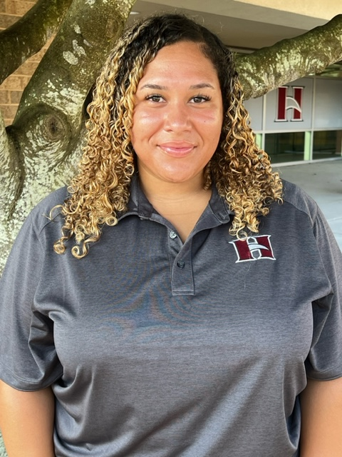
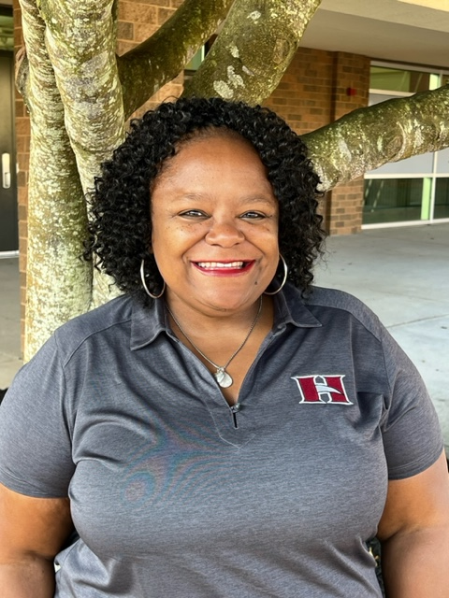
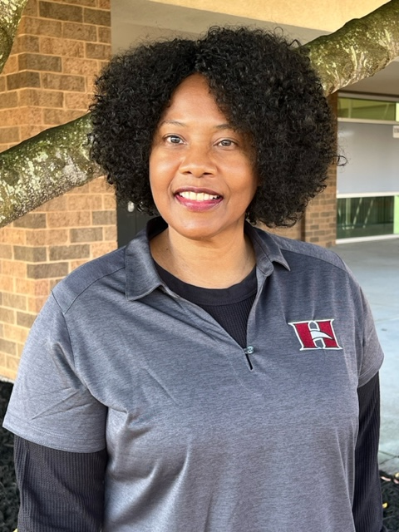
Who is Your School Counselor?
Ms. Berry
(A - Con)
Dr. Wynn
(Coo – Gon)
Ms. Calloway
(Goo - Ko)
Dr. Boyle
(Kp - Od)
Ms. Davis (Oe - Sh)
Dr. Amand
(Si - Z)
Notes:
Please insert department information on this slide.

Slide 4
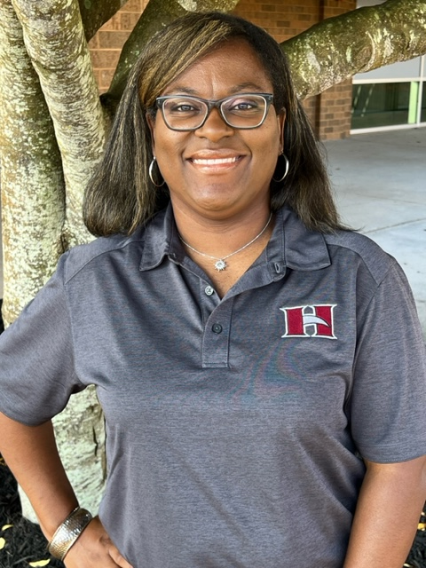
Who is in the School Counseling Office?
Ms. Mitchell
Clerk
Mr. Donlan
Enrollment Clerk
CTLS Learn
Follow us:
@hillgroveschoolcounseling

Slide 5
Reasons to see your School counselor
ACADEMIC
CAREER
PERSONAL

Slide 6
How to reach your school counselor?
Stop by the counseling office with a pass from your teacher
Stop by the counseling office in-between classes to set up an appointment
Send your counselor an email for an appointment
Notes:
Explain how to make an appointment with counselor and add emails as well as any links to an online program that your department is using (such as, youcanbookme.com)

Slide 7
Things to Know
Safety
Harassment & bullying
Tell an adult (teacher, counselor, assistant principal) if you’re being harassed/bullied or know of others
Crisis
A life-threatening situation
Tell an adult immediately
Confidentiality
Limits of confidentiality

Slide 8
Let’s talk about…
GPA
Course Rigor
Transcripts
Promotion Requirements
Graduation Requirements
Dual Enrollment
Your Responsibilities in the Classroom
Notes:
This is the agenda for the lesson.

Slide 9
What is A GPA?
Different kinds of GPA
Weighted vs. Unweighted
Cumulative vs. Core
HOPE (see future slide)
College
Grade Point Average (GPA):
A = 4.0 90-100
B = 3.0 80-89
C = 2.0 74-79
D = 1.0 70-73
F = 0.0 69 and ↓
Notes:
Talking points: Cumulative – includes all classes taken in high school and quality points for honors and AP/IB; Core – includes classes taken in English, math, science, social studies, and world language and quality points for honors and AP/IB; HOPE – includes classes taken in English, math, science, social studies, and world language and quality points (.5) for AP/IB if you made below an A; College – varies from school to school (students should check with individual schools)
Refer to Gafutures initial academic eligibility on HOPE GPA at: https://www.gafutures.org/hope-state-aid-programs/hope-zell-miller-scholarships/hope-scholarship/initial-academic-eligibility/

Slide 10
How do I calculate a GPA?
Step 1: Assign each grade a numeric value
A=4 (90-100%)
B=3 (80-89%)
C=2 (74-79%)
D=1 (70-73%)
F=0 (0-69%)
Step 2: Add all the numeric values together
Step 3: Divide by the total number of credits (classes) attempted
AP and Honors courses earn quality points
AP = +1 quality point
Honors = +0.5 quality point
Notes:
Explain how to calculate the GPA
Use this opportunity to discuss quality points and how they are added.
Refer to Board rule IHA-R for which courses receive quality points.

Slide 11
GPA Examples
Example 1
Algebra I – B = 3.0
World Geography – A=4.0
Intro to Drafting – B = 3.0
Art – B = 3.0
3.0 + 4.0+ 3.0+ 3.0= 13
13/4 = 3.25 GPA
Example 2
H Algebra – C = 2.5
H World Geography – B = 3.5
Intro to Drafting – B = 3.0
Art – A = 4.0
2.5 + 3.5+ 3.0 +4.0= 13
13/4 = 3.25 GPA
Notes:
Can use this or make up your own examples. Invite a student to come to the whiteboard and assist you.

Slide 12
Why take Honors and AP classes?
Provides opportunities to improve study skills
Familiarizes you with college level work
Can boost your cumulative, weighted GPA
Prepares you for big tests (ACT, SAT, EOCs)
Gives you an advantage in college admissions
Allows you to expand your interests
May be eligible for college credit (AP Exam)
Improves critical thinking skills for workforce
BUT… you must find the right balance for YOU; don’t compare yourself to others
Notes:
May want to discuss different colleges and the Freshman Student Profile for UGA and GA Tech vs. other colleges if you are discussing in state. Let them know how many AP classes competitive colleges are looking for.

Slide 13
How Many Credits Do I need to Graduate?
Area of Study | Required Credits
English/Language Arts | 4 credits (9th Lit, American Lit)
Mathematics | 4 credits (Alg I, Geom, Adv Alg)
Science | 4 credits (Bio, Physics/Physical Science, Chem/Earth/ Env Sci)
Social Studies | 3 credits (World, US, Gov/Econ)
World Language/Technical/Fine Art | 3 credits
Personal Fitness | 0.5 credit
Health | 0.5 credit
Electives | 4 credits
TOTAL CREDITS: | 23 credits
Notes:
Refer to Administrative Rule IHE-R for detailed promotion requirements

Slide 14
Promotion Requirements
Grade Level | Required Credits
10th | 5 credits (1 credit each in core English, Math and Science)
11th | 10 credits (2 credits each in core English, Math, and Science)
12th | 16 credits (on track for graduation)
Notes:
IHE-R

Slide 15
Dual Enrollment (DE)
DE is a state funded program that allows 11th and 12th graders to take college classes while completing their high school diploma.
DE also provides limited options for 10th graders
Any 10th grader can take CTAE classes at a Technical College
10th graders who have earned a 1200 SAT or 26 ACT (in one sitting) are eligible to apply to participating DE program
DE pays for 100% tuition, mandatory fees, and required textbooks up to a maximum cap of 30 hours
Attend a Hawk Hour Dual Enrollment Session for next steps
Notes:
Policy IDCH-R
Each school can edit the 4th bullet to add their school-specific next steps for interested students (i.e., talk to counselor, attend information session, etc.)
Here are the benefits to DE – you can present these to your students as appropriate:
Introduces students to college-level coursework.
• Earning college credits while still in high school may enable students to graduate early and/or possibly even earn an associate degree, diploma or certificate.
• Helps students adjust to certain aspects of the college experience (e.g., classes, coursework, and instruction, being on a college campus) so the transition from high school to college may be easier.
• Students who participate in a dual enrollment program are more likely to go to college and get a college degree.
• Students may be able to take classes that are not offered at their high school, especially in subject areas they are interested in for a potential career.
• Participating in a dual enrollment program demonstrates a student’s ability to handle more difficult coursework which is something college admissions officers may look upon favorably during admissions and recruiting.
• Taking college-level classes while still in high school may build confidence and encourage those students who may not be thinking about college to reconsider.

Slide 16
Tips for Success in High School
At a Minimum
Going Above and Beyond
Come to school
Be on time
Have your materials
Pay attention
Complete and submit your assignments
Find out what you missed when absent and make up work in a timely manner
Check your grades
Review & preview notes
Attend tutoring
Communicate with your teachers
Take detailed notes
Study nightly
Keep a calendar
Stay organized

Slide 17
What is HOPE/Zell Miller Scholarship?
HOPE/Zell Miller are scholarships that are awarded to Georgia residents who have demonstrated specific academic achievements. These scholarships assist students with paying for their tuition at any USG, TCSG, or eligible private colleges or universities in Georgia. The criteria varies for each scholarship; however, this is a great way for students to get help with paying for their post-secondary education!
To see your HOPE GPA, visit Gafutures.org

Slide 18
What is HOPE/Zell Miller Grant?
HOPE/Zell Miller are grants that are awarded to Georgia residents who have demonstrated specific academic achievements. These scholarships assist students with paying for their tuition at any TCSG colleges in Georgia. The criteria varies for each grant; however, this is a great way for students to get help with paying for their post-secondary education!
To see your HOPE GPA, visit Gafutures.org

Slide 19
Naviance
Naviance is a delivery system and college/career search engine. We use it to communicate with you and we will use it throughout the year for various activities.
You can access Naviance from the CCSD homepage, or your school’s website.
Notes:
You can include graphics of where on the websites the icons are, if you chose.

Slide 20
Logging into Naviance
Go to www.cobbk12.org
User Name: | Password:
Microsoft 365 User Name | Microsoft 365 Password
Go to
“Find it Fast”
Go to “Naviance”
Continue with CLEVER

Slide 21
Adding STUDENT E-MAIL ADDRESS
Click your Initials in the Header
Choose “My Account”
Click the Pencil Icon/Edit under “Contact”
Scroll & enter your personal email address (not students.cobbk12.org)
Press Save

Slide 22
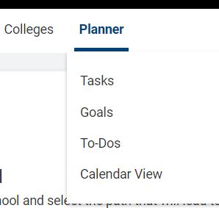
Locating Tasks to Complete
Click on “Home” “Planner" "Tasks”
2 Tasks to complete
Achieve Works Personality assessment
9th Grade BRIDGE Survey

Slide 23
9th Grade bridge law AW Personality assessment
Scroll down to “Tasks You Need to Work On”
1
Select “Complete AchieveWorks® Personality”
2
Answer the question and click “Save and Finish”
4
Select “Take AchieveWorks Personality Assessment”
3

Slide 24
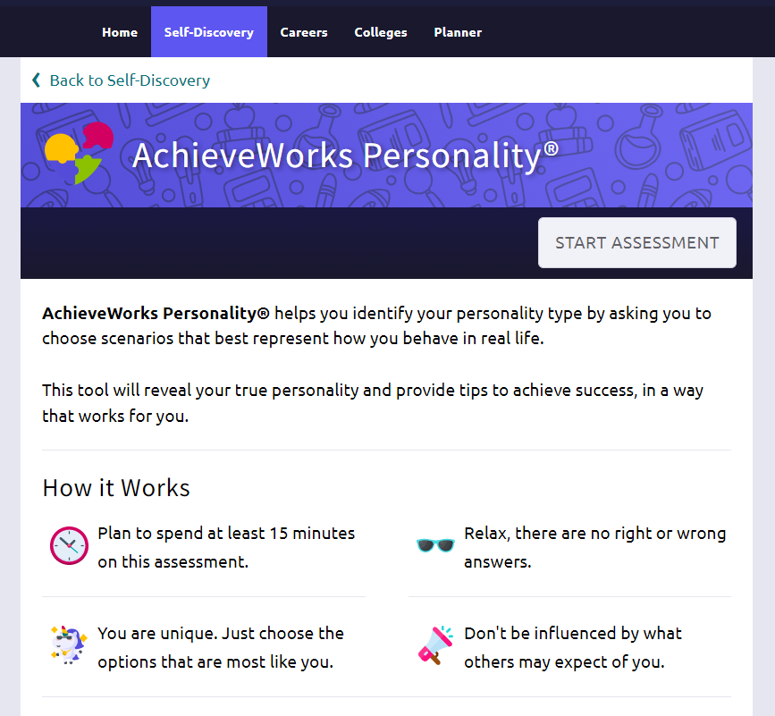
Career Interest Profiler Assessment

Slide 25
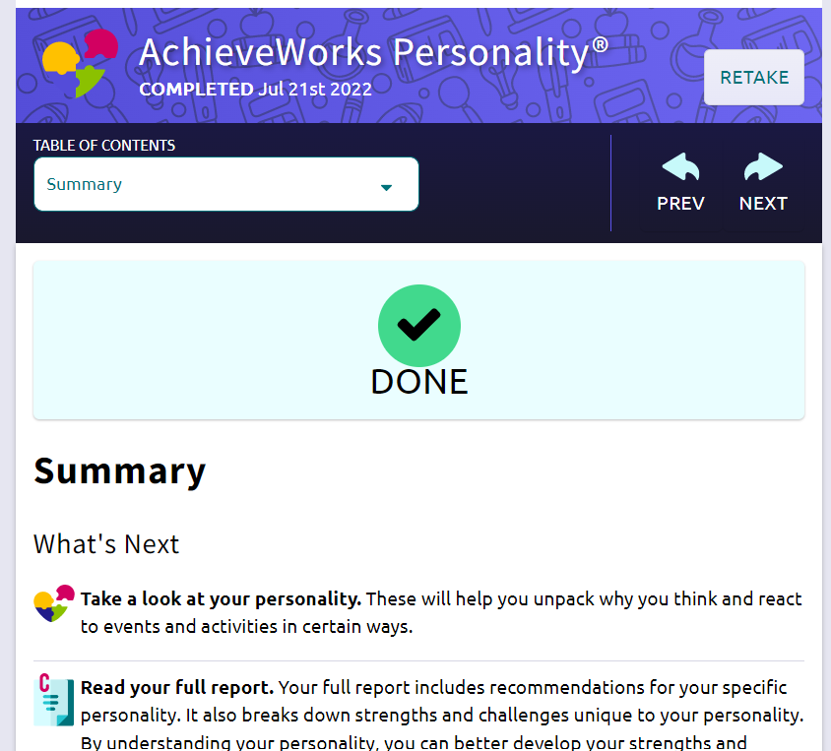
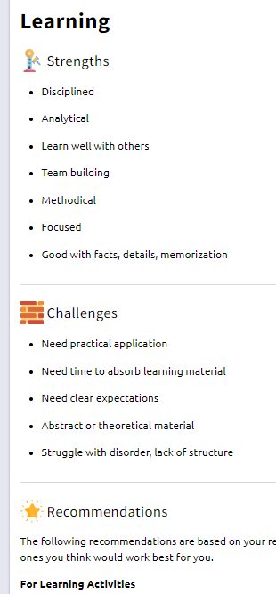
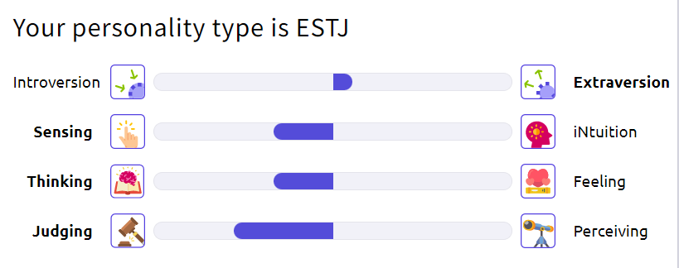
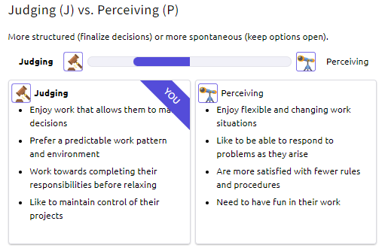
Review results related to your personality

Slide 26
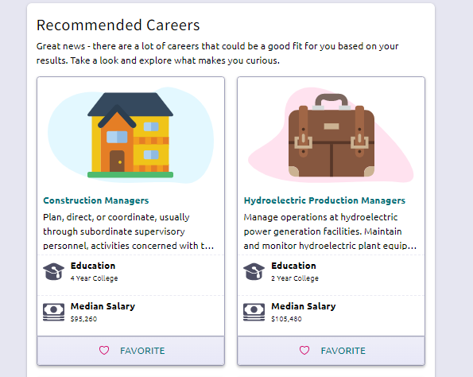
Explore Careers
“Favorite” your Top 3 career interests
(You will list 3 careers in the next survey and these may be the ones you want to list!)
“Favorite”

Slide 27
9th Grade bridge law survey task
Scroll down to “Tasks You Need to Work On”
1
Select “9th grade BRIDGE survey 23-24”
2
Answer all questions
3
Click
“Save and Finish”
4

Slide 28
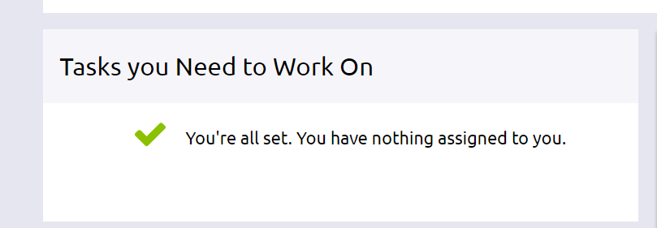
Don’t log out!
Make sure a counselor has verified all Tasks have been completed
Click “My Planner”
Choose “Tasks”
You will see a message this when finished

Slide 29
“If cauliflower can become pizza, you can do anything”

