Slide 1
Rising 6th Grade Parent Night
Notes:
Stump
Welcome and Introductions
Remind online viewers that questions are disabled, but they can always email

Slide 2
Our Mission:
Prepare all students for academic success
Notes:
Stump

Slide 3
School Profile
Current Enrollment: 987
Student Groups:
31% Black
29% Hispanic
26% White
8% Asian
6% Multiracial
Teacher Profiles
70% Gifted Certified
50% Advanced degrees
Notes:
Waltz
Update-add teacher profiles (percentage that's gifted certified (70%), ESOL certified, advanced degrees)

Slide 4
Communication
Weekly Newsletters
CTLS
ParentVue
All progress reports are posted electronically – no paper copies
Fridays at Five
All teachers post assignments & resources
Notes:
Waltz

Slide 5
Multiple Teacher Expectations
Your student will have 7 different teachers
Please include students full name when contacting teachers
Please allow up to 24 hours for reply
Student Accountability
StudentVue & CTLS
Homework – Nightly studying
Due dates
Computer
Organization
Binders, folders, supplies, instruments
Agendas
Notes:
Waltz

Slide 6
6th Grade Schedule
2022-2023 Daily Bell Schedule
Homeroom/Breakfast | 8:50-9:11
1st Period | 9:15-10:05
2nd Period | 10:09-10:59
3rd Period / Lunch | 11:03-12:40
4th Period | 12:44-1:34
5th Period | 1:38-2:28
6th Period | 2:32-3:22
7th Period | 3:26-4:15
Notes:
Waltz

Slide 7
Connections Classes
Two periods/Day
Year-long
Band
Chorus
Orchestra
9 Weeks
PE
Art
Technology
Family & Consumer Science (FACS)
Notes:
Moss

Slide 8
Daniell Performing Arts
Band, Chorus, and Orchestra
Classes are part of the school day leaving time for students to participate in sports and clubs
Year-long commitment
No prior knowledge needed
Concerned about the financial aspect? We are always more than willing to assist.
To learn more or to sign up for a Performing Arts Class visit:
Be Part of the Band & Orchestra (bepartofthemusic.org)
Instrument Test Drive
Wednesday, August 2 from 5 – 7
Saturday, August 5 from 10 - 1
Notes:
Moss

Slide 9
Core Academic Classes
English Language Arts
Math
Science
Social Studies
Enrichment
Placement is data driven
Math
Writing
Reading
Science PBL
Notes:
Moss.
We won't make any decisions until we have EOG scores back and end of the year RI and MI scores, so please wait until your students and their scores roll up to Daniell – usually after July 1

Slide 10
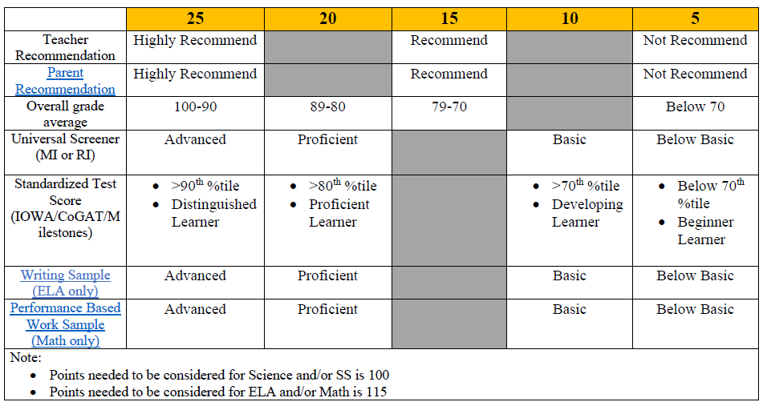
AC Classes Recommendation form for 22-23
Notes:
Moss
This is what we used last year and we are modifying it for this year. We use as much data as possible to place students.

Slide 11
Pathways Towards HS Credit
HS Algebra
Math 7/8
Math 6/7
HS Physical Science
AC Science
HS Visual Art
Teacher Recommendation
HS Spanish
Spanish Academy
Data Driven
HS LAS
Leadership, Law, and Public Service Academy
Teacher Recommendation
Notes:
Moss

Slide 12
PBIS
SWARM –SWARM is the model for behavior expectations
S – Show Positive Leadership
W – Work Hard
A – Accept Accountability
R – Respect Others
M – Make Good Choices
Student Recognition:
SWARM Points
J.J. Days
Student of the Month
Honors Days
Golden Stinger
Notes:
Waltz

Slide 13
Lockers
Students are assigned lockers around 2nd week of school
Gym lockers are also provided, if students are dressing out
Need Practice?
Apps
Combo Lock 101 ($.99)
School Lock ($.99)
Master Lock
Notes:
McAfee

Slide 14
Transportation
Here Comes the Bus – Bus Tracking
Bus routes will be updated in late July 2023
Bus Notes
Needed when riding a different bus home
May be denied because other bus is full
Not needed when riding home via car
Car riders are not given placards
Notes:
Waltz

Slide 15
The Logistics of Being a Middle Schooler
Middle School Hours (9:15 – 4:15)
There is NO ASP
Have a plan if your student:
Misses the bus
Loses their key
Feels unsafe
Hygiene – MS Bodies are different
Practice good hygiene
Emergency Contacts
Make sure your student knows phone numbers & home address
Notes:
Pope

Slide 16
The Logistics of Being a Middle Schooler: The First Days
Something to write with and on
Supply lists will be available during the summer
First days bring a pen or pencil and some paper
Meet & Greet
CTLS Message & Daniell Website
Notes:
Pope

Slide 17
The Logistics of Being a Middle Schooler: Tech
Cell Phones
Not required
Not allowed
Do not call or text your student throughout the day or have them call or text you
Please use the front office phones for communication
Technology
Cobb provided laptops
Students are expected to bring their laptop every day
Notes:
Pope

Slide 18
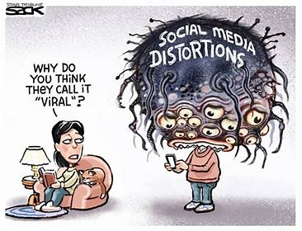
Social Media & Middle Schoolers
Distractions
Drama
Deceptive
Dangerous
Notes:
Pope & Stump

Slide 19
Supports for your Students
Student Support Team: 2 Counselors and a School Social Worker
How do we support your student?
Individual meetings, mediation, small group sessions, classroom lessons
What do we talk about?
School Issues: study skills, goal setting, test anxiety, grades, discipline
Home Life: divorce (parents), siblings, living situation
Personal Issues: self-esteem, body image, self-harm, suicidal thoughts
Social Issues: drama, teasing/bullying, relationships
Grief/Loss
Your Future!
Trusted Adults
Notes:
Pope

Slide 20
School Safety
Visitors show ID
Must have an appointment
Perimeters secured
Campus Officer
Adult Supervision
Safety Drills
Trusted Adults
Building relationships to be proactive
ACT Trained – Acknowledge, Care, Tell
Notes:
Stump

Slide 21
Extracurricular Opportunities
Clubs – Over 25 at Daniell
DNN (Daniell News Network)
Run Girl Run
Anime club
Art club
Garden Club
National Junior Honor Society
Lego Robotics
Academic Bowl
Spanish Club
Intramurals
SHS Junior Jacket Athletics
Baseball
Basketball
Cheerleading
Cross Country
Football
Lacrosse
Softball
Notes:
Stump

Slide 22
PTSA
J.J. Daniell Middle School staff and students are fortunate to enjoy the support of many families and community members.
Support and encourage the Daniell faculty, staff, and students throughout the school year.
For more information on the PTSA and their activity, please visit their Facebook page – Junior Jackets PTSA
Notes:
Stump

Slide 23
Why Daniell?
Top 2% most diverse public middle schools in Georgia (Niche)
4 Consecutive 5-star climate rating
AdvancED Accredited School
2018 ASCA RAMP award counseling program
Georgia School of Excellence
MIE certified school
Ability to earn up to 5 HS credits
Increases in gifted enrollment
8th Grade Academies
PBIS Operational School
½ staff have earned advanced degrees
70% of the staff is gifted endorsed
We care about kids!
Notes:
Stump

Slide 24
Thank You
Ms. Amy Stump, Principal
Amy.Stump@cobbk12.org
Mr. Nicholas Waltz, 6th Grade Administrator
Nicholas.Waltz@cobbk12.org
Ms. Cayce Pope, 6th Grade Counselor
Cayce.Pope@cobbk12.org
Ms. Angelica Moss, Scheduling Administrator
Angelica.Moss@cobbk12.org
For more information and to watch a recording of this session please visit www.cobbk12.org/daniell

