Slide 1
KINDERGARTEN ORIENTATION
#PreviewTheView
3.21.24
MOUNTAIN VIEW ELEMENTARY SCHOOL

Slide 2
Our Teams

Slide 3
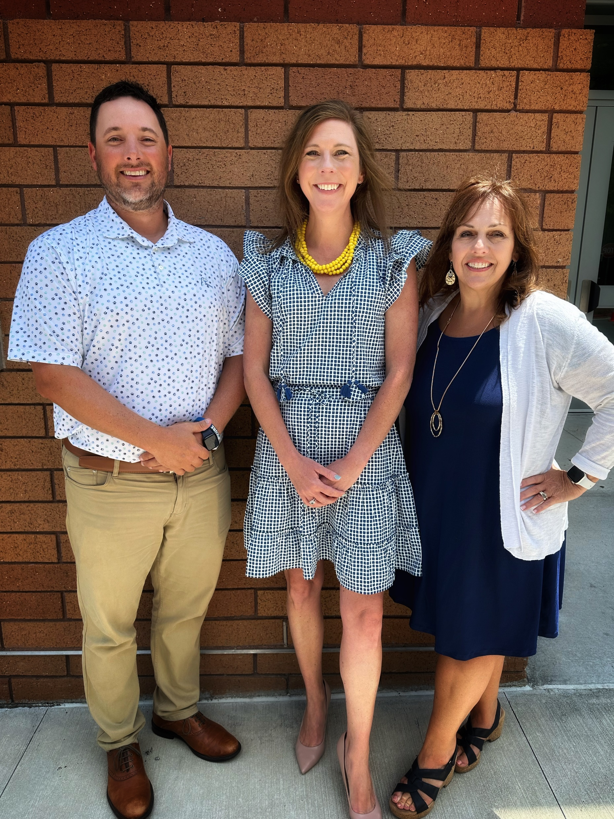
Our Administration
Dr. Katie Derman, Principal
Mrs. Sherry Green, Assistant Principal
Mr. Kevin Johnson, Assistant Principal

Slide 4
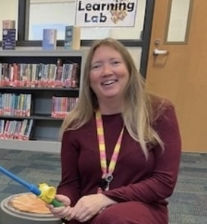
Our Kindergarten Counselor
Mrs. MacDonald
Works to proactively support students
Provides tools and resources for our families, students and staff
Focuses on emotional
Notes:
Mrs. MacDonald
Works to proactively support students
Provides tools and resources for our families, students and staff
Focuses on emotional

Slide 5
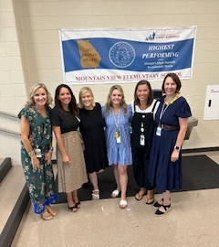
Our Kindergarten Teachers
Courtney Cook
Vanessa Fennell
Melanie Roman
Abigail Gunter
Shelby Russell
Emily Smith
Notes:
Insert fun pics of teachers

Slide 6
The Classroom is Calling…

Slide 7
Our Focus

Slide 8
Safety
Our building procedures ensure student and staff safety
The Enrolling Adult (Student Information in ParentVue)
ASP Safety (Eleyo)
Ongoing Drills and Training

Slide 9
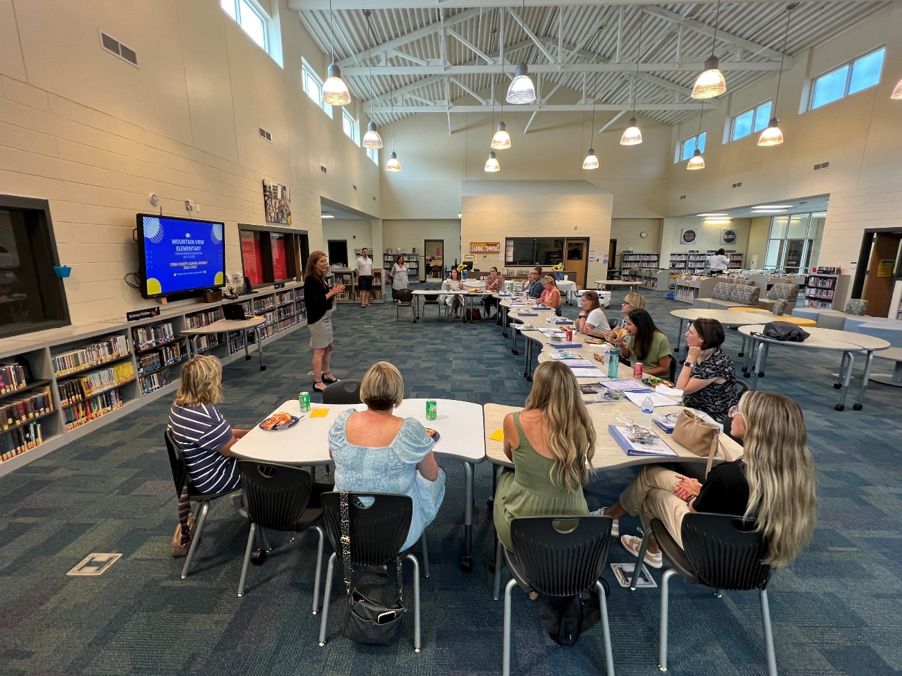
Strategy
Built Teams
New Teacher Institute
Maintain High Expectations
Collaborative Planning & CCC Work
Professional Learning
Notes:
Team Oriented
Launched New Teacher Institute
Not sure what Pop Up PL is

Slide 10
Sample Kindergarten Schedule
7:20-7:50 Arrival /S.T.E.M. Time
8:00- 8:30 W.I.N. Time
8:30- 9:15 Specials
9:15- 10:15 Writing/Phonics
10:15-10:45 Lunch
10:45-11:05 Recess
11:05-12:05 Calendar/Math/Centers
12:00-12:45 Literacy Centers
12:45 -1:30 Science/Social Studies
1:30-1:50 Café (Read Aloud) & Snack
1:50 -2:05 Pack-up/End of Day Meeting /Dismissal

Slide 11
Kindergarten Readiness

Slide 12
Kindergarten Readiness Skills
Uses self-control
Follows simple directions
Cooperates with others
Finishes tasks
Makes transitions easily
Uses the restroom independently
Asks questions to learn and or solve problems
Can button, zip, fasten clothing after restroom use
Can carry on a conversation with peers and adults

Slide 13
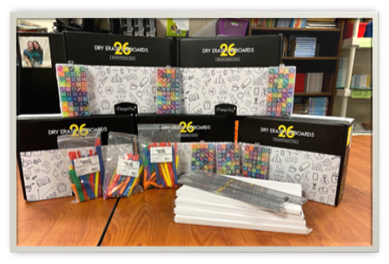
Kindergarten Readiness Skills
Knows first and last name
Writes first name
Knows personal information when asked
Knows 8 basic colors and shapes
Counts and recognizes numbers to 10
Likes to play counting games
Is beginning to identify letters and sounds
Enjoys art, music, and movement activities
Notes:
Insert a pic from a classroom if you want to replace

Slide 14
How To Get Involved

Slide 16
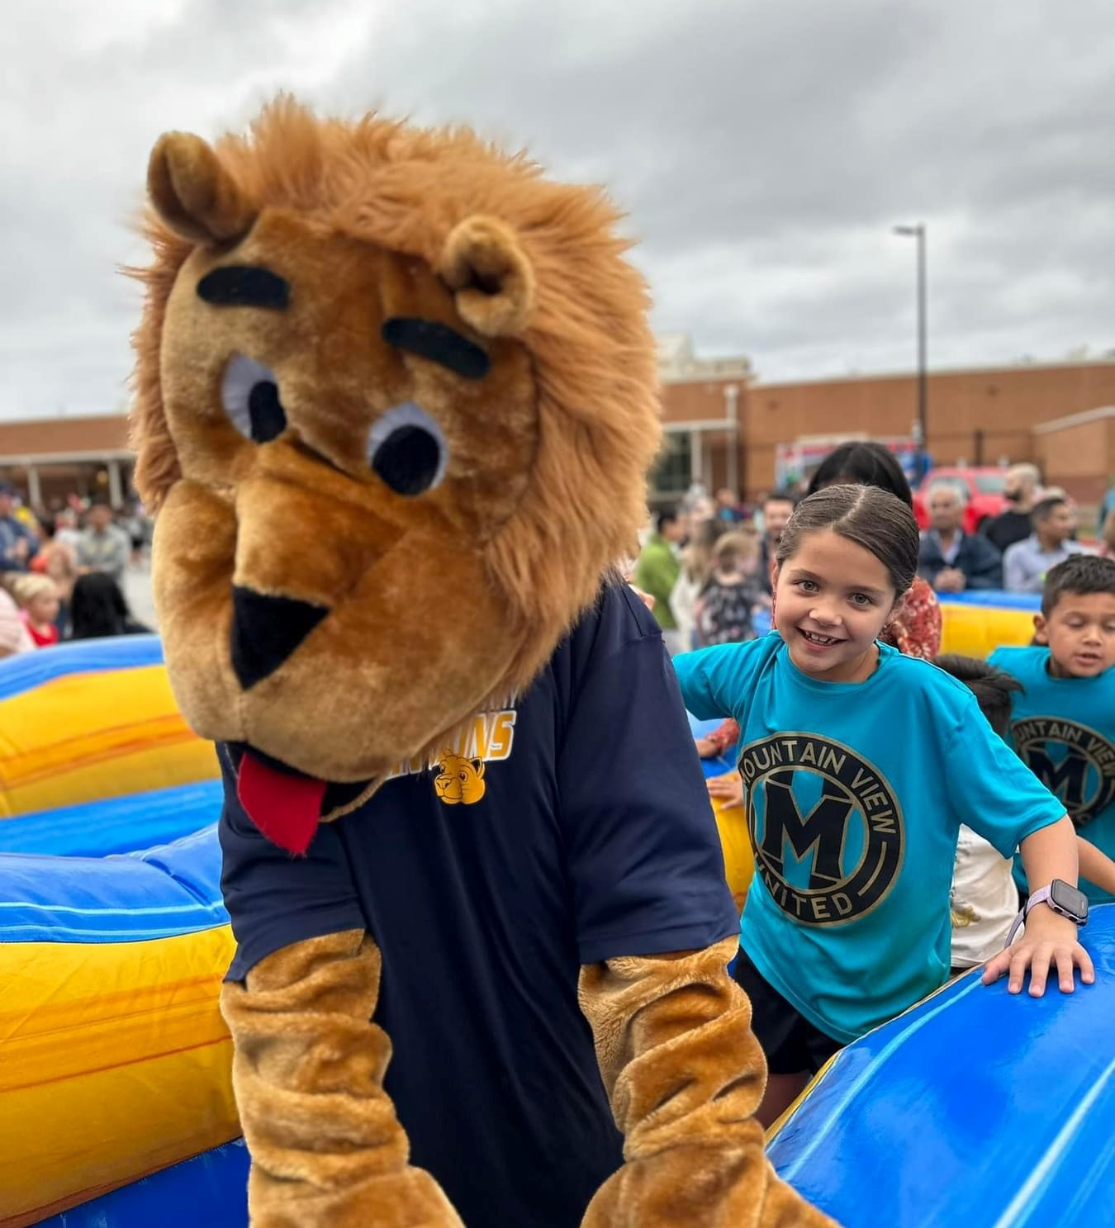
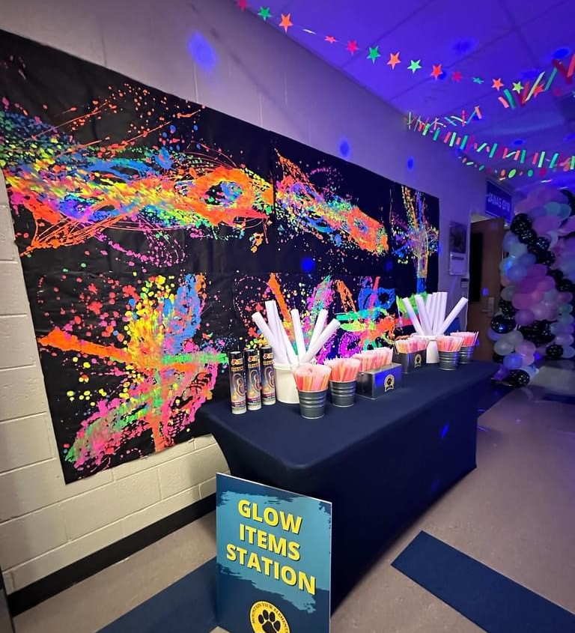
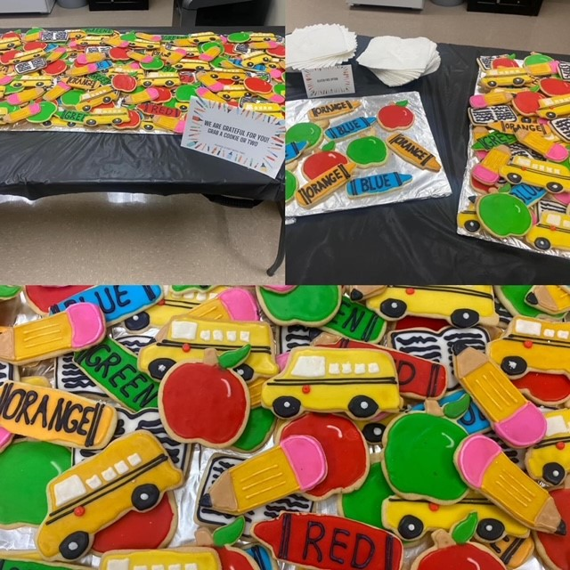
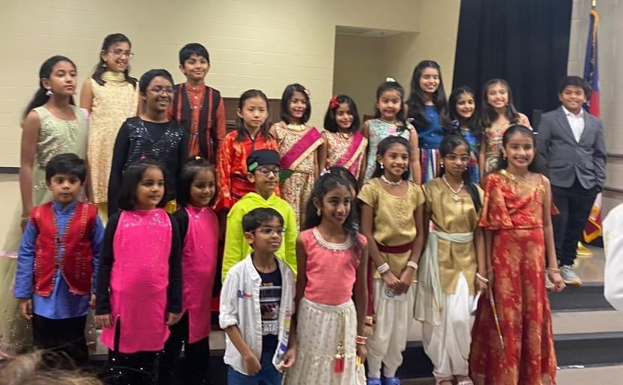
PTA Activities

Slide 18
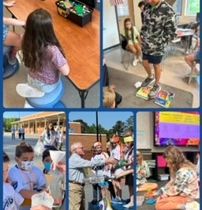
Foundation Fun

Slide 19
Next Steps
Notes:
Next Steps or Important Dates – Any calls to action?

Slide 20
Enrollment
Georgia law requires that kindergarten students must be five years old on or before Sept. 1 and first grade students must be six years old on or before Sept. 1 to be registered.
New student registration is currently available. To register go to the Cobb County website at:
https://www.cobbk12.org/page/291/student-enrollment
Notes:
Next Steps or Important Dates – Any calls to action?

Slide 21
Registration
There are FIVE (5) main documents required of ALL students prior to being enrolled in the District.
1. Certificate of Immunization
2. Certificate of Vision, Hearing, Dental, and Nutritional Screening: a completed 3300 Form.
3. Proof of Birth Date: Birth Certificate or Passport
4. Proof of Residency: The following two proofs of residency are required: Current mortgage statement/ OR current lease/OR current property tax bill AND current monthly utility statement (gas, water, or electric).
5. Social Security Number
Questions? Email Gail Arkenberg-
Gail.Arkenberg@cobbk12.org
Notes:
Next Steps or Important Dates – Any calls to action?

Slide 22
Academics
Academic Information is listed under
→ Parent Resources on the CCSD Website.
Learning and Assessing by
Grades Kindergarten Information:
http://academics.cobbk12.org/index.php/ad/kinder-learning-e/
Notes:
Next Steps or Important Dates – Any calls to action?

Slide 23
Kindergarten Screenings
Appointments will be made through our Sign-Up link.
Student must have an appointment to be screened.
Parents can walk their children in and remain inside the building.
July 8-10 and July 18-19th. 8:30am – 4:30pm
Kindergarten Screening Link
Notes:
Next Steps or Important Dates – Any calls to action?

Slide 24
Class Placement
2024-2025 Optional and Confidential Class Placement Parent Input form Click here for the link. The due date is 4/19/24 and we will be unable to accept late forms.
Notes:
Next Steps or Important Dates – Any calls to action?

Slide 25
#TheBestView
Thank you for joining us!
Notes:
Next Steps or Important Dates – Any calls to action?

