Slide 1
CAMPBELL MIDDLE SCHOOL Principal’s Advisory Council
February 27, 2023

Slide 2
MEMBERS
2 Staff – Kiersten Martin and Jessica Richardson
2 Parents – Latoya Palmer-Addy and Beth Seelinger
2 Community - Tim Gould and Shawn Freeman
1 Counselor - Alex Gorrell
1 Rep from Title 1 - Dalia Saldierna (Parent Facilitator)

Slide 3
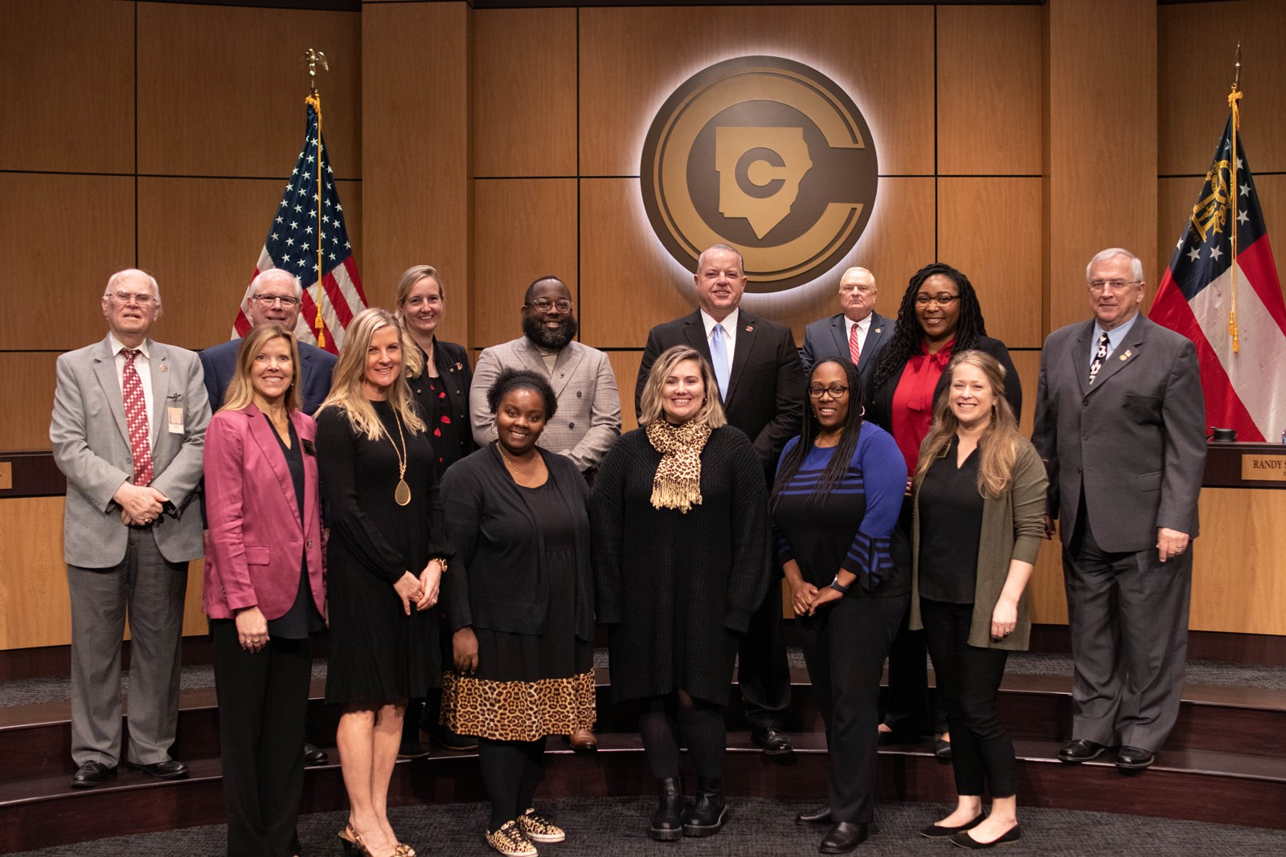
FROM THE BOARD MEETING
CMS COUNSELORS RECOGNIZED FOR RAMP (Feb. 16th)
ASCA RAMP CEREMONY JULY 17 @ 7pm Georgia World Congress Center

Slide 4
TESTING
EOG / EOC
April 24th - May 2nd 8th grade testing
May 3rd - May 5th 1 7th grade testing
May 8th - May 10th 6th grade testing

Slide 5
UPCOMING STUDENT EVENTS
March 9th Walk & Roll to School
Goodie Bag for participating students
March 10th Fresh Air Friday & $1 Hat Day
Ice Cream Truck with your PBIS Points
March 16th Lion King the Musical (CMS Drama)
March 20th PTSA Color Battle Pep Rally
March 23rd CMS 8th Grade IB Showcase
Light Snacks Provided
March 30th 7th Grade Zoo Trip
March 31st PTSA Color Battle Fundraiser Event
$30 raised from the color battle gets you into the event (this is Fresh Air Friday)

Slide 6
UPCOMING GRADE LEVEL EVENTS
FIELD DAYS
6th grade – April 28th
8th grade - May 5th
7th grade – May 12th
Each Grade Level Will Have:
Events set by PE
Tug of War
Inflatable Obstacle Course
Sumo Wrestling or Gladiator (TBD)
Kona Ice

Slide 7
UPCOMING 8th GRADE EVENTS
8th GRADE ONLY
8th Grade Dance
May 19th – Food = Carrabba’s Italian Grill
8th Grade Fun Day
May 22nd This is an early release day
9:45 Chick Fil A Breakfast (Biscuit / Chips/ OJ) $10
10:45 Inflatables in the gym / Game Day Truck
11:45 Lunch from Zaxby’s out in the Stadium
12:45 Pie Teacher in the face ☺

Slide 8
UPCOMING 8th GRADE EVENTS
8th GRADE ONLY
8th Academic Signing / Awards / Yearbook Signing Day
May 23rd
8th Grade Awards Ceremony Live (9:45)
Wall of Honor – All A’s All 3 Years
Principal’s Honor Roll – All A’s for Q4
Academic Signing Ceremony
Announce Magnet Students / CITA Students
*(they can take a pic in front their school sign)
Individual Teacher’s Students of the Year
Superlative Winners
Watch 8th Grade Video
Students Walk the Halls to say goodbye to 6th & 7th
Yearbook Signing
It is a grab and go lunch from the cafeteria and students will report to the stadium to sign yearbooks

Slide 9
UPCOMING STUDENT EVENTS
8th GRADE ONLY
8th Grade Drive Thru Ceremony
May 24th –Parade (Starts at the gym)
Station 1: Entrance / Traffic Line
Station 2: Welcome Signs & Drive Thru Directions
Station 3: Check In
Station 4: Mr. Thompson announces name
Station 5: Havis gives student certificate
Station 6: Bubble machine / Confetti / Streamers
Station 7: 8th Grade Teacher Picture (Noise makers-Horns)
Station 8: PTSA Sign or Sweet Treat? TBD by PTSA
Times: will be by homeroom teacher
9:45 ELA Homerooms
10:00 Math Homerooms
10:15 Social Studies Homerooms
10:30 Science Homerooms

Slide 10
Finally – CMS Foundation
1st Courtyard Renovation should be starting this summer ☺

Slide 11
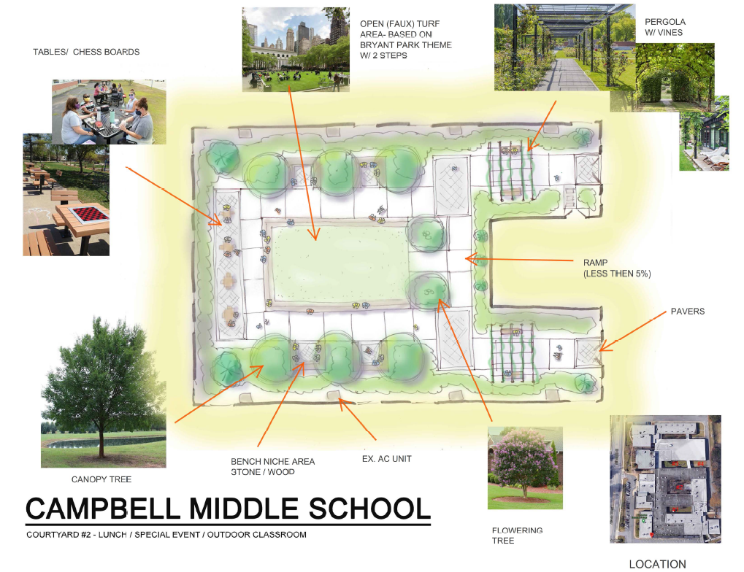

Slide 12
Title 1 $70,000 … this is what they approved
Items for EACH STUDENT | Quantity | Unit Cost | Total
Composition Notebooks | 2,600 | 0.88 | 2,288
Spiral Notebooks | 2,600 | 0.56 | 1,457
Pocket Folder with Prongs | 5,200 | 0.18 | 936
Sharpened Pencils Pack, 12 Count | 1,300 | 2.58 | 3,354.00
Colored Pencils 8 pack | 1,300 | 1.65 | 2145
Handheld Pencil Sharp w/ Cover | 1,300 | 1.2 | 1,560
Cap Pencil Erasers | 1,300 | 32.69 | 555.73
Highlighters | 1,300 | 20.42 | 755.54
Total |  |  | $13,051

Slide 13
Title 1 $70,000 … this is what they approved
Items for EACH TEACHER | Quantity | Unit Cost | Total
Copy Paper Box | 100 | 42.49 | 4249
ream of each colored paper (bright yellow, orange, green, blue) | 200 | 5.72 | 1144
boxes of pens paper mate 0.7 gel (black, blue, red) | 40 | 15.29 | 623.6
boxes of pencils (144) | 100 | 9.74 | 974
box of glue sticks | 50 | 13.52 | 676
Pack of scissors (2pk) | 300 | 1.79 | 537
Box of large paper clips (pack of10) | 100 | 7.74 | 770
pack of 12 yellow sticky notes | 100 | 8.99 | 899
boxes of expo markers (black) | 100 | 16.55 | 1,655
expo erasers | 100 | 6.29 | 629
bottle of expo cleaning solution | 100 | 3.31 | 331
Total |  |  | $12487.6

Slide 14
Title 1 $70,000 … this is what they approved
Items for Math & Literacy Outdoor Classroom (Instructional Materials)
OUT TEACH STEM Station: Whiteboard/Weatherboard Bench Seating (for 25-30) Earth Science Station w/ Sand & Rock Bins Maker Space Bin Measuring Poles Veggie Bed w/ SQ FT Gardening Value Counter
Total |  |  | $14,000

Slide 15
Title 1 $70,000 … this is what they approved
Items for CCSD Professional Development | # People | Stipend | Total
STEAM TEAM Collaboration Post Planning Stipend (May 30 &31) 9 to 1pm | 8 | 75x2 | 1200
Cobb InTech Stipend (June 1 &2) 8am to 4pm | 5 | 150x2 | 1500
Cobb Exceptional (SWD) Conference (June 6) | 1 | 150 | 150
Cobb Steam A Polooza Stipend (June 21 & 22) | 8 | 150x2 | 2600
Rising 6th Grade Boot Camp Stipend (July 17 & 18) | 10 | 75x2 | 1500
Total |  |  | $6950

Slide 16
Title 1 $70,000 … this is what they approved
Items for GEORGIA Professional Development | # People | Stipend | Registration | Total
Innovative Schools Summit (June 20-24) | 2 | 150x2 | 650x2 | 1600
IB MYP Workshop (June 13-15) ONLINE | 1 |  | 950 | 950
IB MYP Workshop (July 11-13) North Atlanta High School | 4 | 150x4 | 1295x4 | 5780
Total |  |  |  | $8330

Slide 17
Title 1 $70,000 … this is what they approved
Items for OTHER Professional Development | # People | Travel & Hotel | Registration | Total
ISTE Conference in Philadelphia (June 25-28) | 1 | $2500 | 700 | 3200
Making Schools Work Conference in Orlando (July 18-21) | 2 | 2500x2 | 500X2 | 6000
Total |  |  |  | $9200

Slide 18
SO …
That is about $64000
ALL of them still need to eat and be reimbursed for gas
Anything left after that will stay with us into the August / September
Plus, whatever we haven’t spent in the current Title budget
Still left to buy … agendas for next year and charging stations for core teachers

Slide 19
Prioritized Need #1: All students need to be able to read and write on grade level
Teachers need to provide more support in helping students understand reading and writing standards via the learning questions
Teachers need to implement STEAM strategies during the work session to better assist students with reading and writing concepts
Teachers need professional learning in differentiated strategies for teaching students how to write with clarity of expression

Slide 20
Prioritized Need #2: All students need to be able to perform on grade level in math
Teachers need to provide more support in helping students understand mathematical standards via the learning questions
Teachers need to implement STEAM strategies during the work session to better assist students with math problems
Teachers need to model problem-solving skills for real world math problems and provide background knowledge

Slide 21
Prioritized Need #3: All students need to demonstrate social emotional control
Teachers need to provide lessons regarding classroom and school behavior expectations
Teachers need to utilize the PBIS awards App and infraction system
Teachers need to promote IB global mindedness and IB traits

Slide 22
Agenda for Next Meeting
Next Meeting is March 20th @5:30PM
Any new information from the district will be discussed
Title 1 School Improvement Plan

