Slide 1
Campbell Middle State of the School Title 1 Meeting September 22, 2022
AGENDA
What is Title I
Who is Funded
ESEA Parents Right-to-Know
Parental Involvement
The Budget
Sample Title 1 Survey Items
3 GOALS of the Title 1 PLAN
Dr. Camille Havis
Principal
Ms. Dalia Saldierna
Parent Facilitator

Slide 2
AGENDA ITEM #1
Title I, Part A is one of many programs governed by the Elementary and Secondary Education Act or ESEA.
The program makes it possible to expand the basic educational programs that schools offer with services and interventions that support struggling learners.
What is Title 1?
Additional money for teachers, coaches, supplies

Slide 3
AGENDA ITEM #2
There are two kinds of programs that schools can fund through Title I, Part A
School wide means that all students - based on academic need - are eligible to receive the additional instruction this federal program will fund.
EX: Morning Tutoring/ Math Support
Targeted assistance makes it possible to provide the same benefits but only to selected students based on academic need.
Who is being funded?

Slide 4
AGENDA ITEM #3
ESEA directs schools to notify parents of four requirements of a Title I - Part A program.
Professional qualifications of teachers and paraprofessionals
All CMS Teachers AND Paraprofessionals are certified by the state of Georgia
Notification if your child’s teacher is not highly qualified
All CMS Teachers are HQ
Individual report card that lets you know how your child is progressing
Synergy Parent Vue Accounts
Notification if the school has entered a need improvement status.
CMS is not on any state list for academic improvement
ESEA Parents Right-to-Know
4 Requirements

Slide 5
AGENDA ITEM #4
Why is parental involvement important?
Families have a major influence on their children’s achievement in school and through life. When schools, families, and community groups work together to support learning, children tend to do better in school, stay in school longer, and like school more.
How does parental involvement affect student achievement?
Earn high grades and test scores, and enroll in higher-level programs;
Pass their classes, earn credits, and are promoted;
Attend school regularly; and
Graduate on time!
Parental Involvement

Slide 6
AGENDA ITEM #5
The CMS Title 1 Budget is as follows:
2 Full Time Academic Coaches
1 Math Support Teacher
= 85% of the Budget
The remaining 15% of the budget goes towards instruction:
Moby Max IB Workshops
IXL Performance Contracts
PBIS Rewards App Supplies
Morning Study Hall Student Agendas
Usage of Title 1 Funds

Slide 7
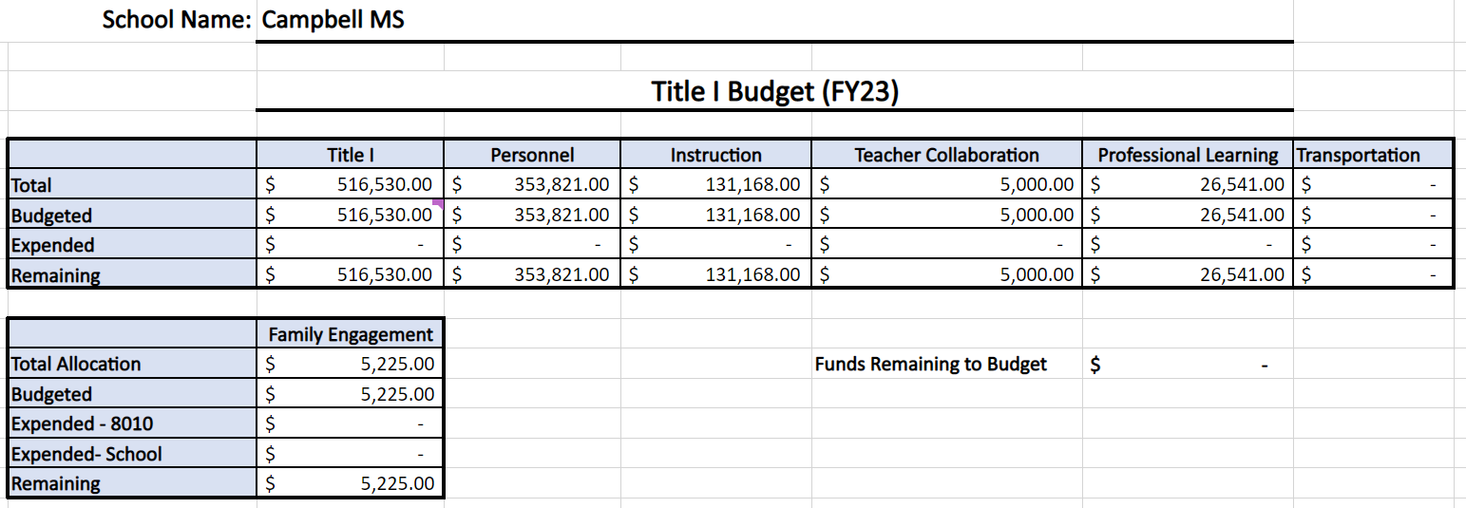
THE BUDGET

Slide 8
FROM THE BUDGET
Personnel | Budgeted
 | $353,821 (includes benefits)
Math Support Teacher | Tiondra Grant
Academic Coach ELA | Jessica Richardson
Academic Coach MATH | Candace Ellis
Parent Facilitator | Dalia Saldierna

Slide 9
FROM THE BUDGET
WEB BASED SUBSCRIPTIONS | Budgeted
 | $33,000
IXL – ELA/ MATH/ SCI/ SS | $27,000
Flocabulary | $2,700
Moby Max | $3,500

Slide 10
FROM THE BUDGET
SUPPLIES | Budgeted
 | $33,300
Student Agenda | $7000 PAID
Copier Toner
Dry Erase Markers
Copy Paper
PBIS APP | $7000 PAID
Binders, Notebooks, Folders

Slide 11
FROM THE BUDGET
CONFERENCES & WORKSHOPS | Budgeted
 | $26,541
Innovative Schools Summit
National Association of Science Teachers
Title 1 Conference
IB Workshops & IB World Conference
Foreign Language Association of Georgia
Georgia Teachers of ESOL
Georgia Council for Teachers of English
Georgia Council for Teachers of Math

Slide 12
AGENDA ITEM #6
Do you have a clear understanding of how the school qualifies for Title I assistance?
Do you have a clear understanding of how the funding is being used?
Did you attend Title I Parent Night?
Sample
Survey
Items

Slide 13
AGENDA ITEM #7
GOAL #1
Implement differentiated interventions to decrease the number of students scoring below basic by 10% on the Reading Inventory by the end of the 2022-2023 school year.
School wide writing strategy for ELA
CTLS Assess for common summative assessments
Read 180 Training for support teachers
Monitoring Student Data via CTLS
Reading Inventory Scores
Reading Inventory Incentives
Monitoring of IB Unit Plans
Highlights of 2022-2023 Title 1 Plan

Slide 14
AGENDA ITEM #8
GOAL #2
Implement differentiated interventions to decrease the number of students scoring below basic by 10% on the Math Inventory by the end of the 2022-2023 school year.
School wide writing strategy for Math
CTLS Assess for common summative assessments
Math Dream Box Training for support teachers
Monitoring Student Data via CTLS
MATH Inventory Scores
MATH Inventory Incentives
Monitoring of IB Unit Plans
Highlights of 2022-2023 Title 1 Plan

Slide 15
AGENDA ITEM #9
GOAL #3
Utilize Positive Behavior Intervention System, Social Emotional Learning for IB Traits, and Restorative Circles / Conferences to decrease the number of students receiving discipline referrals by 10% by the end of the 2022-2023 school year.
Social Emotional Learning via Restorative Circles
Restorative Conferences for Discipline
IB Learning Traits
IB Approaches to Learning Skills
PBIS Traits
Highlights of 2022-2023 Title 1 Plan

Slide 16
Your Input is Needed
Please provide feedback
https://forms.office.com/r/CJ0EzEdzgT

